Slide 1

Cognitive deficits in Covid-19 survivors
Adam Hampshire
Professor in Restorative Neuroscience
Department of Brain Sciences
Imperial College London
a.hampshire@imperial.ac.uk

Slide 2
Assessment platform - what is the Cognitron?
Flexible platform for developing & deploying cognitive assessments online and via custom Apps
>100 web-optimised cognitive paradigms
Multi-language support
Inbuilt questionnaire generator
Easily extensible using libraries/templates
Supports server-side optimisation studies
Has handled up to ~36,000 concurrent users
Supporting a growing body of studies, clinical cohorts, registers and trials
Generates participant facing population standing graphs and clinician facing diagnostic reports

Slide 3
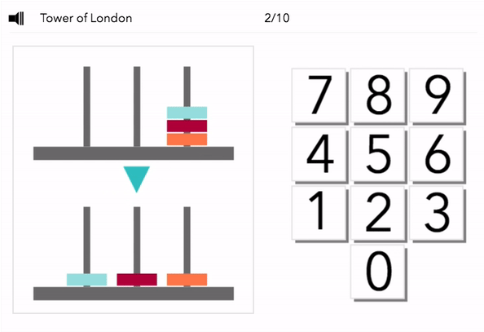
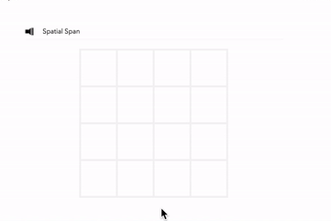
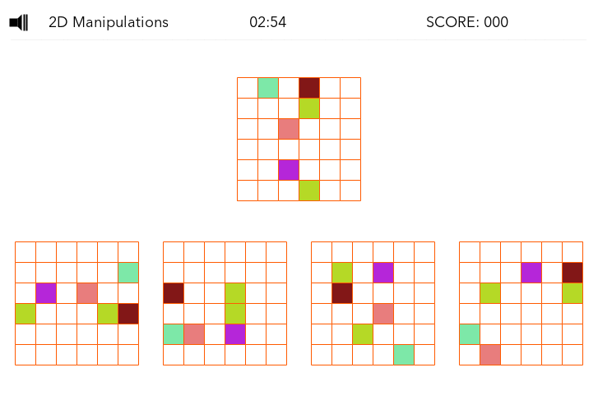
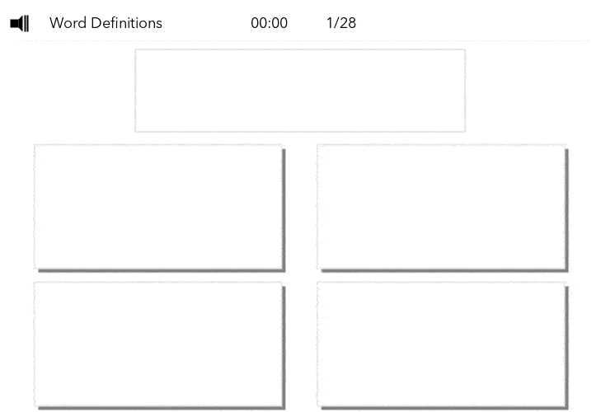
Cognitron task designs
Tasks are
Build on established assessment paradigms but optimised for online deployment
Run on smartphones, desktops and laptops in any modern browser
Minimal sensitivity to device
Public & Patient input with diverse clinical populations
Ability to collect large normative datasets rapidly
Brief (max 3 mins), minimally gamified and engaging, enabling custom batteries to be generated for specific purposes
On the fly algorithms that generate stimuli, enabling deployment at many repeat timepoints

Slide 4
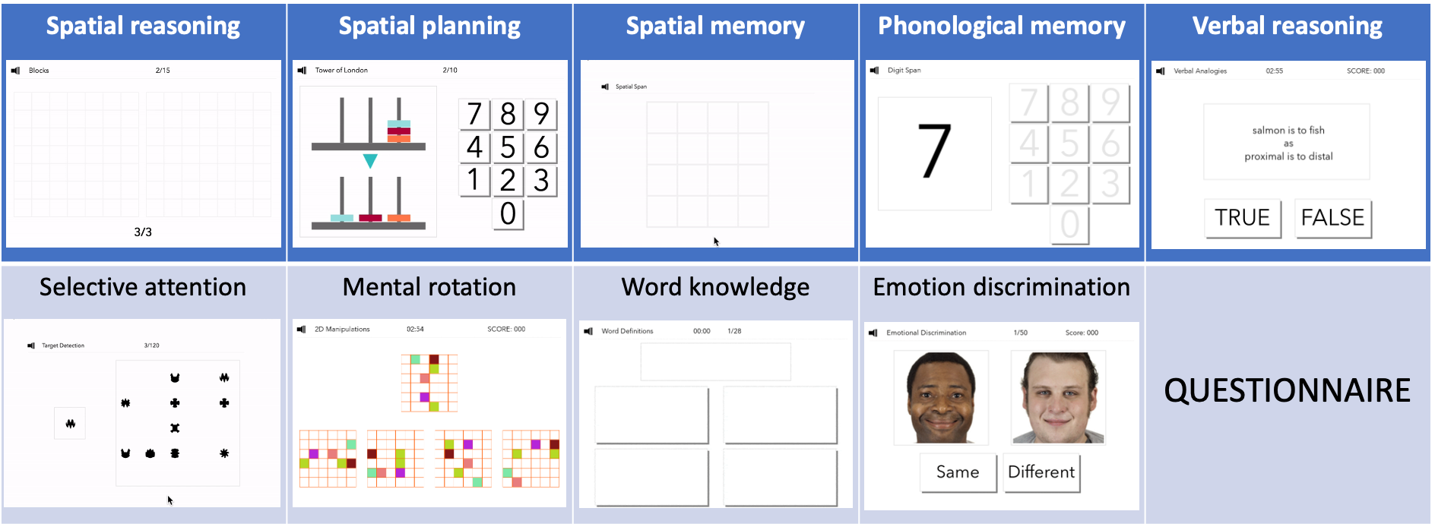
What was the Great British Intelligence Test?
Collaboration with BBC2 Horizon in 2020
Aimed to map cognitive abilities and mental health in fine detail across the British population
High profile, advertised on BBC News and BBC Homepage
Deployed using Cognitron platform, delivers objective cognitive tests & bespoke questionnaires via any device with a browser (PC/tablet/phone)
Not advertised as a COVID-19 related study
Covid related questions plus extended medical conditions and mental health scales added in May 2020
Sociodemographics
Lifestyle
Personality
Medical conditions
Mental health
Pandemic impact
Mental health results - Hampshire et al., Nature Communications - 2021
Covid-19 PTSD results - Chamberlain et al., BJP open - 2021
Covid Cognition results – Hampshire et al., eClinicalHealth - 2021
Free text analysis – Hampshire et al., Royal Society Interface Focus– in press

Slide 5
Study timeline
January 1st | Articles appear on BBC news and BBC main homepages
May 1st| Questionnaire expanded in response to pandemic
Articles no longer in prominent locations, site still running
May 2nd| BBC2 Horizon documentary goes live & articles reappear on BBC
pilot
ongoing

Slide 6
Design considerations: decorrelation
Controversial what the main aspects of human cognitive ability are
Much research has focused on trying to identify latent variables by examining how peoples scores on different tests correlate with each other.
Typically test scores have a positive correlation, although the strengths vary widely
There also are clusters within this ‘positive correlation manifold’
This is the basis for a century old debate regarding how many different types of human intelligence there are …
Diagnostically, for a battery of tests to be efficient, we want it to measure different aspects of cognition, i.e., to be decorrelated
Also important to consider the medium that a person is tested within. Browsers and Apps run on different devices in the wild.
Plus there is not a one size fits all battery. Tests that are optimal for measuring subtle executive or reasoning deficits will be too complex for a dementia patient to understand what they are supposed to be doing.
Hierarchically clustered schemaball of the cross
correlated scores from the many cognitive tasks
on the Cognitron website

Slide 7
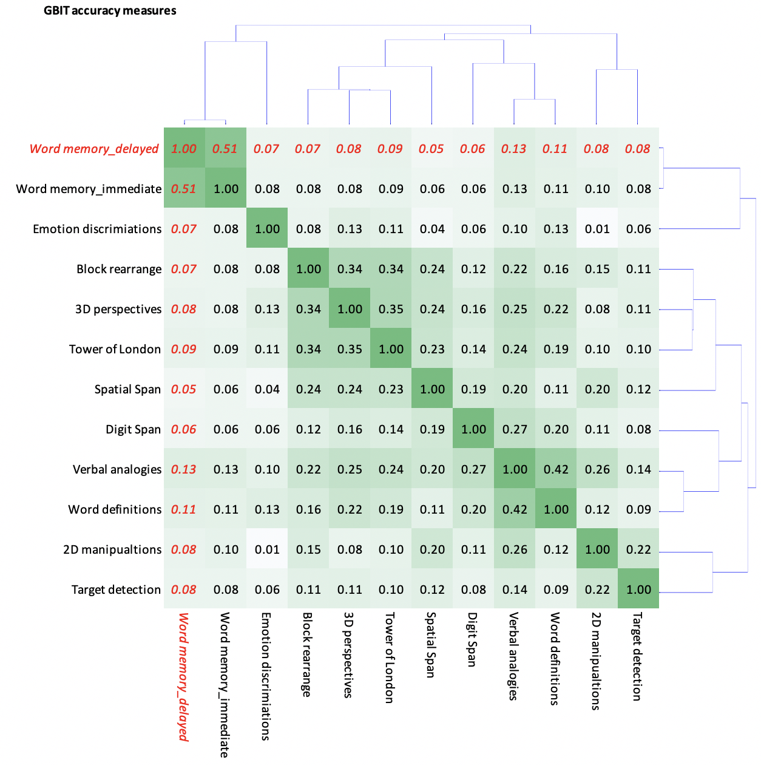
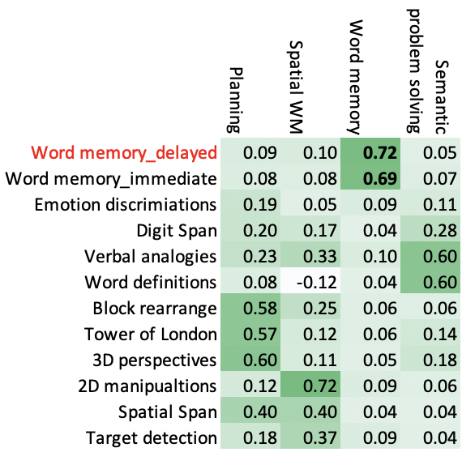
How were the tasks selected?
Low sensitivity to device (phone/tablet/PC)
Partially decorrelated enabling multiple cognitive domains to be assessed
Global cognition ‘g’ still measurable
% variance
24.69
11.77
11.44
9.18
8.42
7.61
6.98
5.60
5.29
4.88
4.12

Slide 8
What was the Great British Intelligence Test?
Resulted in ~390,000 datasets with ~120,000 in May
Mean age=46yrs, 14% minority ethnic , ~1:1 male/female split & thousands non-binary, broad education range, tens of thousands with pre-existing neurologic or psychiatric conditions in May alone
Data collected at 2 follow up time points
December2020-Jan2021
June-July 2021
Sociodemographics
Lifestyle
Personality
Medical conditions
Mental health
Pandemic impact
Mental health results - Hampshire et al., Nature Communications - 2021
Covid-19 PTSD results - Chamberlain et al., BJP open - 2021
Covid Cognition results – Hampshire et al., eClinicalHealth - 2021
Free text analysis – Hampshire et al., Royal Society Interface Focus– in press

Slide 9
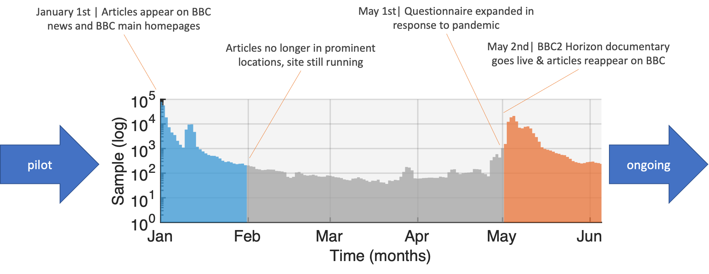
Covid-19 survivors – respiratory symptom severity and treatment
May subset - 81,337 usable cognitive datasets with optional Covid-19 questionnaire
Participants organised by respiratory outcome as a proxy for severity
12,689 participants believed they’d had the virus
192 hospitalised, 44 on ventilators
386 positive biological tests (almost all of those who were in hospital)
 | Not ill | Ill without respiratory symptoms | Respiratory symptoms without home assistance | Respiratory symptoms with home assistance | Hospitalised No ventilator | Hospitalised Ventilator
No/don’t know/awaiting results | 68648 | 8726 | 3286 | 159 | 126 | 6
Yes | 0 | 212 | 100 | 14 | 22 | 38

Slide 10
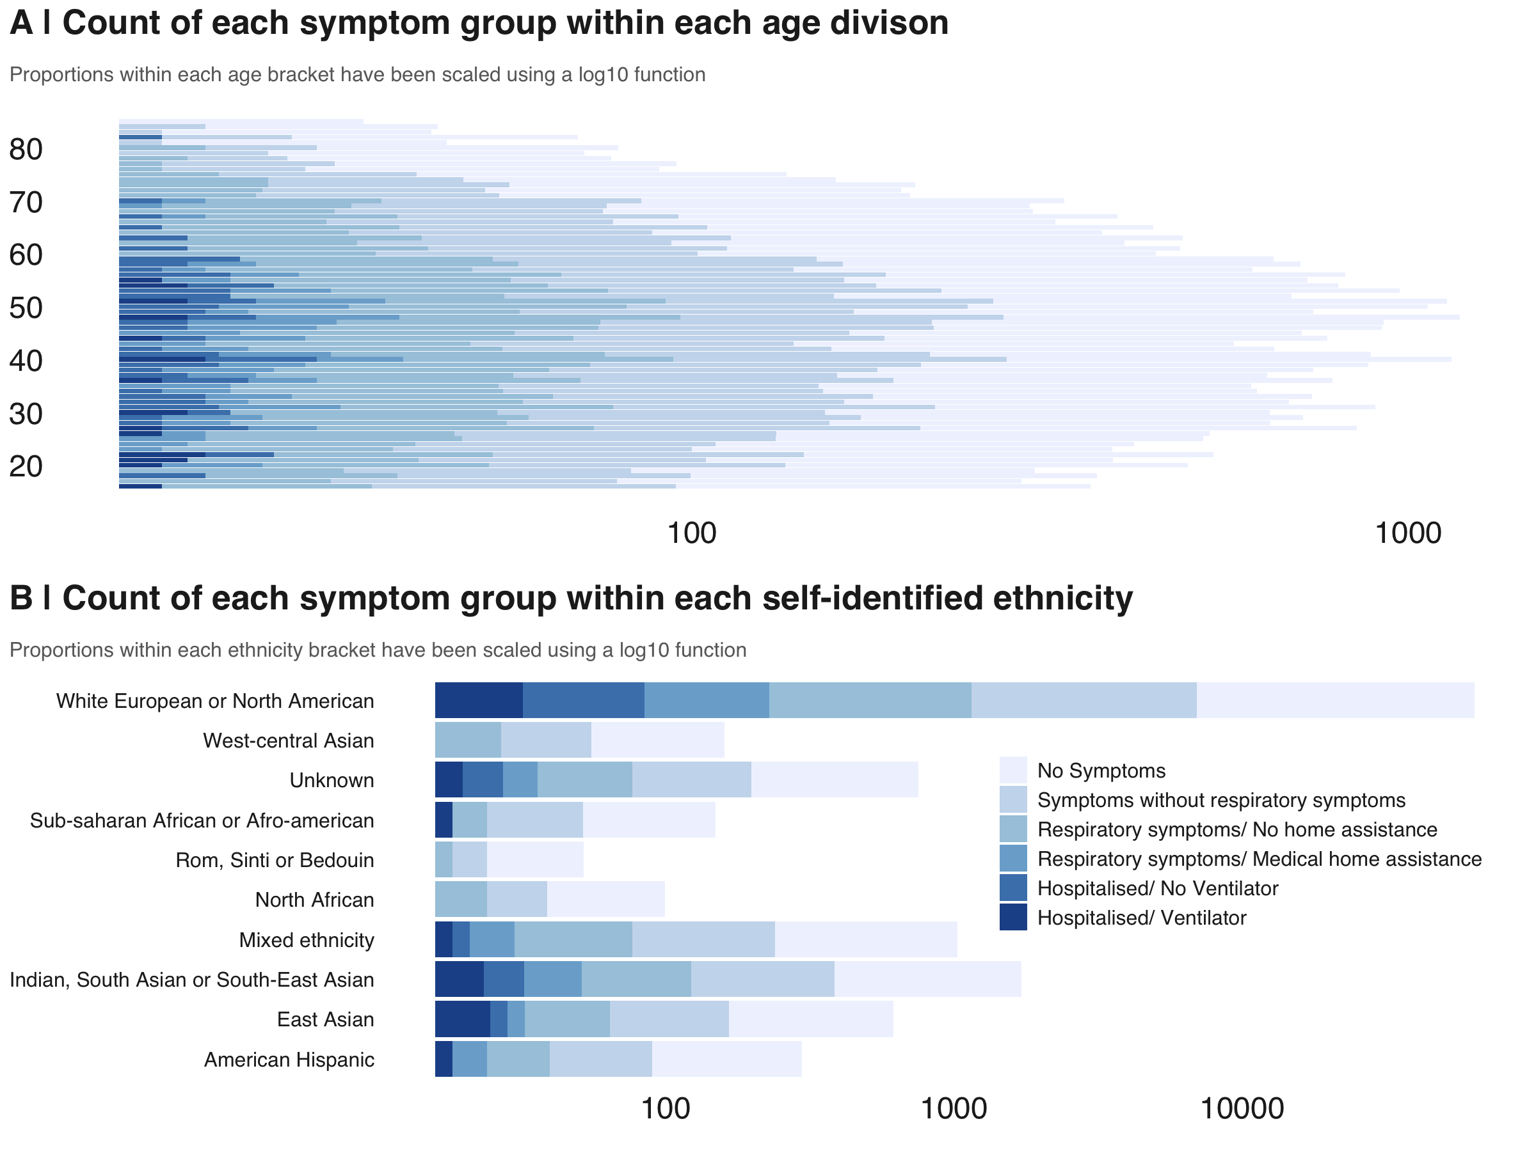
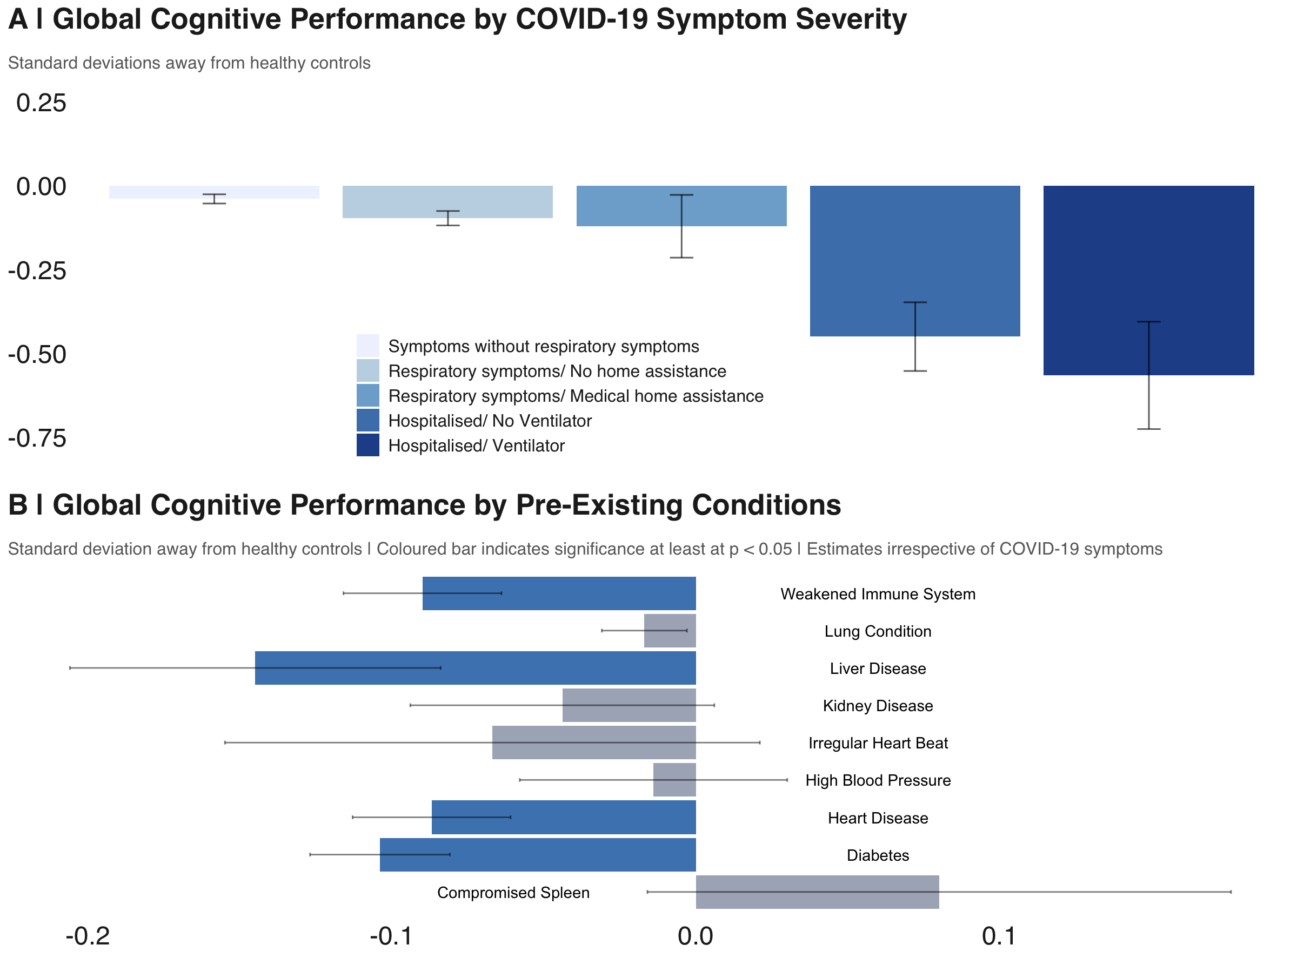
Covid-19 survivors – age range
May subset - 81,337 usable cognitive datasets with optional Covid-19 questionnaire
Participants organised by respiratory outcome as a proxy for severity
12,689 participants believed they’d had the virus
192 hospitalised, 44 on ventilators
386 positive biological tests (almost all of those who were in hospital)
Those who were ill spanned a broad age (mean 44yrs) and demographic range
 | Not ill | Ill without respiratory symptoms | Respiratory symptoms without home assistance | Respiratory symptoms with home assistance | Hospitalised No ventilator | Hospitalised Ventilator
No/don’t know/awaiting results | 68648 | 8726 | 3286 | 159 | 126 | 6
Yes | 0 | 212 | 100 | 14 | 22 | 38
Log N

Slide 11
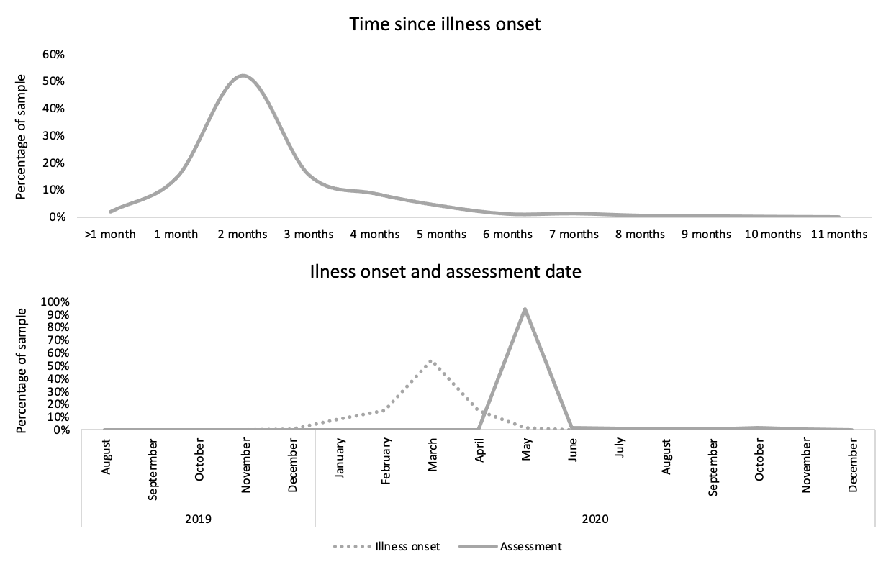
Covid-19 survivors – time from illness
Reported time of illness vs time of cognitive assessment in bio-confirmed cases
Illness onset coincides with first wave peak
Assessment offset mode ~2 months post illness

Slide 12
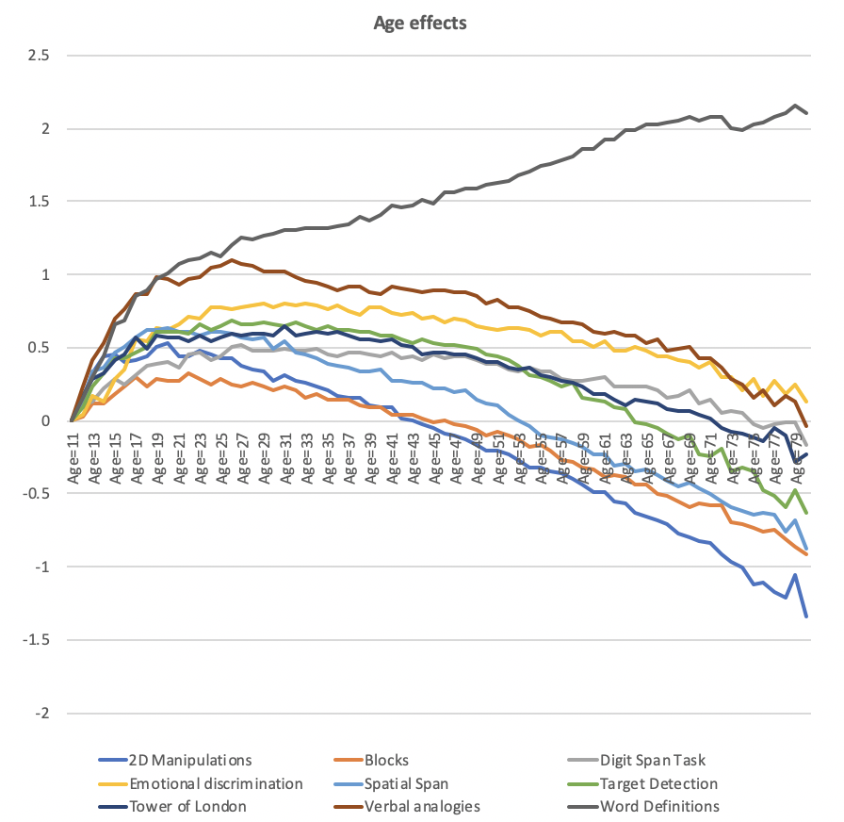
Age curves: N=~390,000
Important to account for sociodemographic variables
Age especially associated with cognitive performance
Also education level, first language and other factors to varying degrees

Slide 13
Model-based approach to culture fair assessment
Population factor – cognitive score associations make interpretation of objective assessment results difficult
Simple linear modelling to predict performance on each task
Train on one subset of individuals
Predict task scores based on
Age to third order
Handedness
Sex
Education level
English first language (binary)
Testing device
Explains held out data global composite at r~=0.45
The very large normative dataset can be used to enable culture fair assessment, calculating deviation from expected score for similar people
Observed vs predicted score

Slide 14
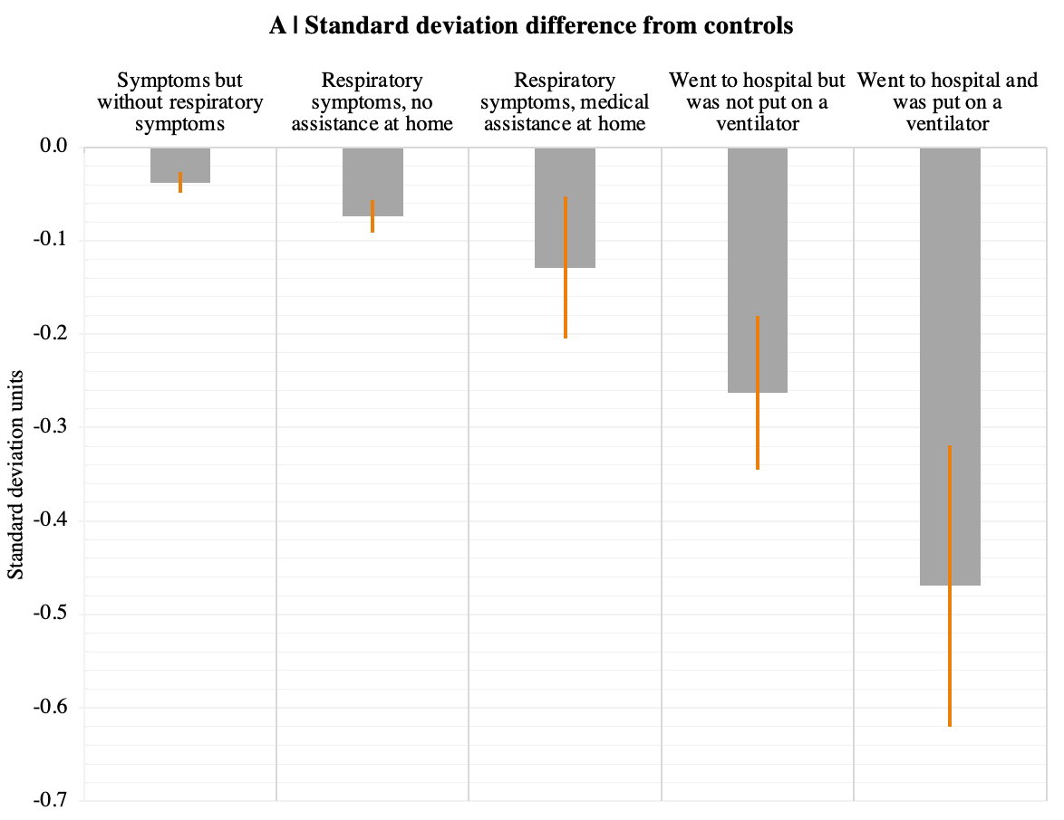
Covid-19 survivors – global cognitive deficits
After accounting for
age,
gender,
ethnicity,
handedness
country of residence
first language
pre-existing conditions
occupational status
economic status
depression
anxiety
insomnia
tiredness
Global cognitive performance varied as a function of respiratory severity
Even the least severe group shows a very small cognitive disadvantage
Error bars SEM
Hampshire et al., Lancet EClinicalMedicine 2021

Slide 15
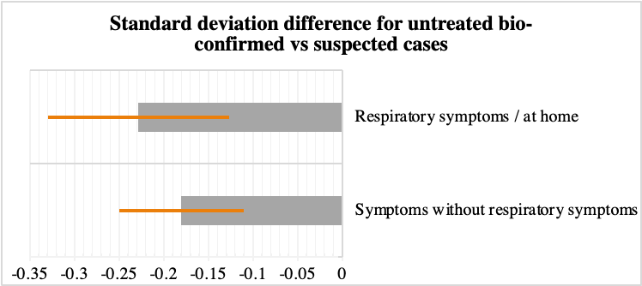
Covid-19 survivors – global cognitive deficits
Global cognitive performance examined in mild bio-confirmed cases only
More substantial cognitive underperformance evident in those with and without respiratory symptoms
Error bars SEM
Hampshire et al., Lancet EClinicalMedicine 2021

Slide 16
Covid-19 survivors – global cognitive deficits
Global cognitive performance examined in mild bio-confirmed cases only
More substantial cognitive underperformance evident in those with and without respiratory symptoms
Scale of deficit even amongst mild cases greater than for conditions predisposing to Covid-19 vulnerability
Also, correlation with time since illness was statistically non significant – though note, most participants in the sub-acute / early chronic phase
Hampshire et al., Lancet EClinicalMedicine 2021

Slide 17
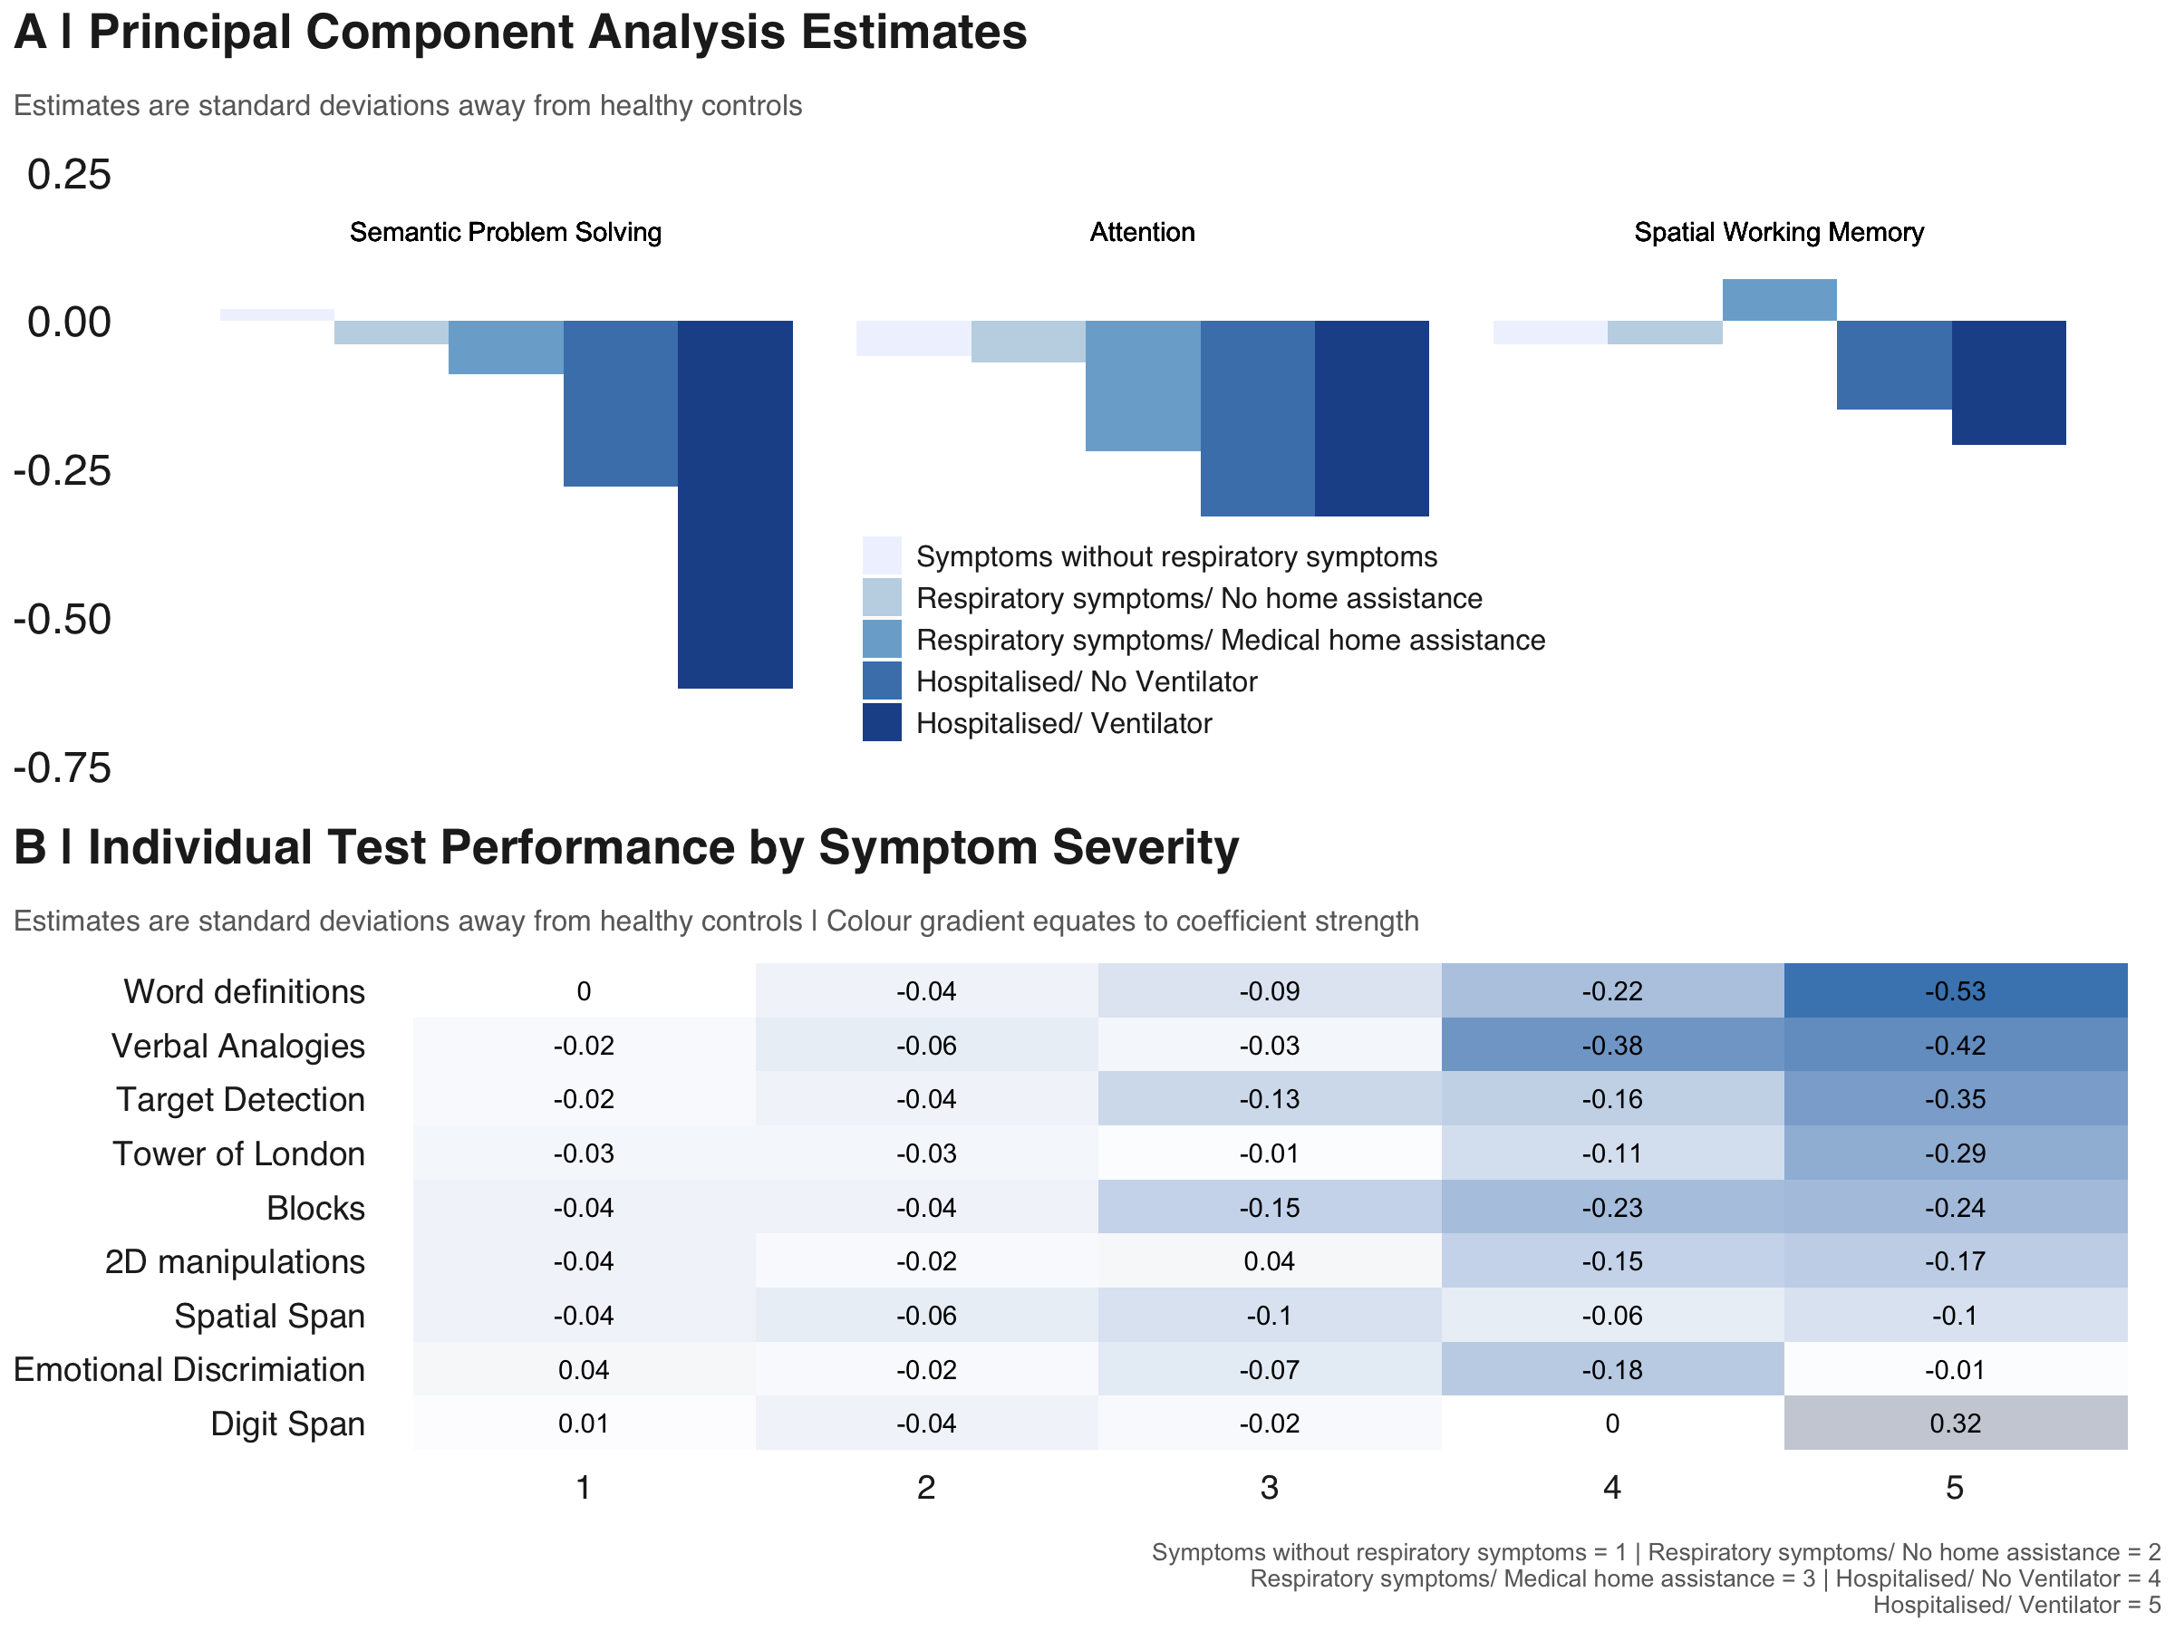
Covid-19 survivors – domain specificity of cognitive deficits
At a finer grain cognitive deficits appeared to be greatest for certain cognitive domains
Especially semantic problem solving and attention
Hampshire et al., Lancet EClinicalMedicine 2021

Slide 18
Today’s workshop
Citizen science projects have the strength of numbers but also limitations
Self report
Not controlled conditions
The above work was followed on with hospital and epidemiological cohort research. We will analyse some of that data today.
Tutorial
Walk through how to handle behavioural data
Data cleaning
Preprocessing
Walk through how to leverage big normative data in order to examine cognitive deficits in people who were hospitalized with COVID-19
Challenge
Apply this approach to examine the nature of cognitive deficits in people with dementia

